Slide 1
FAIR Management System
BY
Backbenchers
Members:
Md. Rakibul Hasan Roni Md. Monir Hossain Ram Babu Kushwaha
Sharmin Sultana
Yasmin Naima

Slide 2
What it does?
Keeps visitor information.
Allows user to add new zones(Up to 7).
Keeps track of the no. of visitors at each zone.
Shows zone specific visitor information.

Slide 3
Project Development tools
Microsoft Visual Studio 2013
Microsoft SQL Server 2012
.Net Framework 4

Slide 4
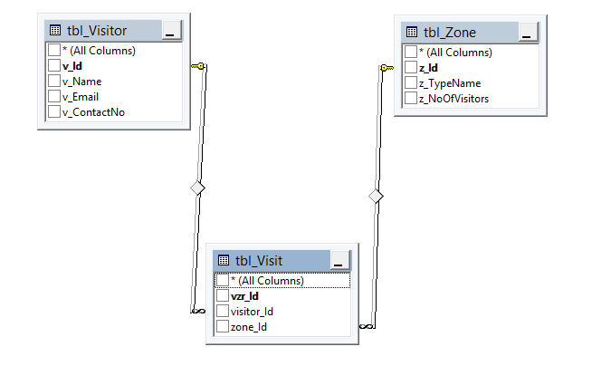
Relationship Diagram

Slide 5

Main UI

Slide 6
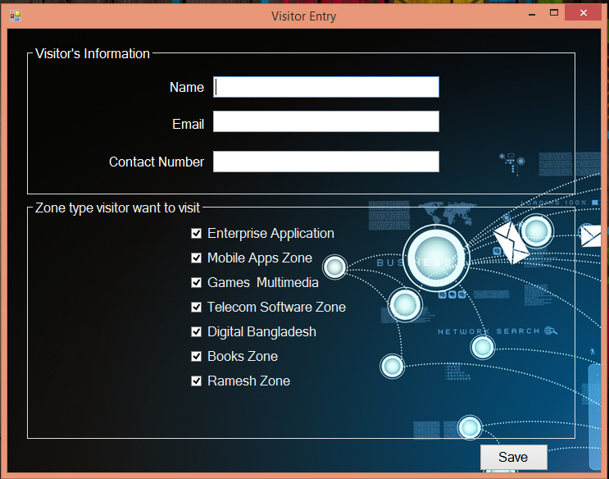
Visitor Entry UI

Slide 7
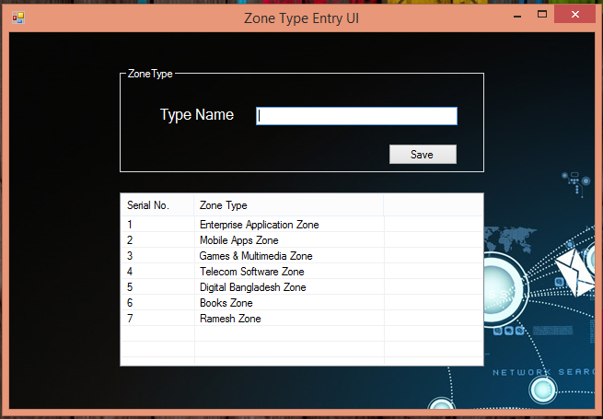
Zone Type Entry UI

Slide 8
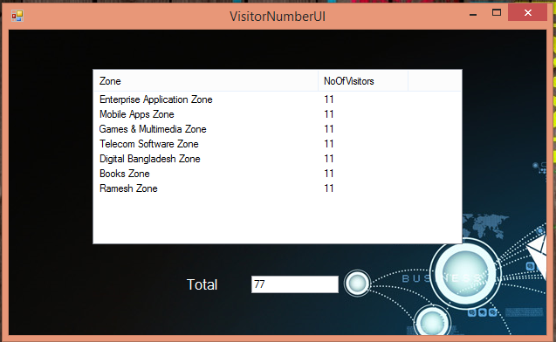
No. Of Visitors Per Zone UI

Slide 9
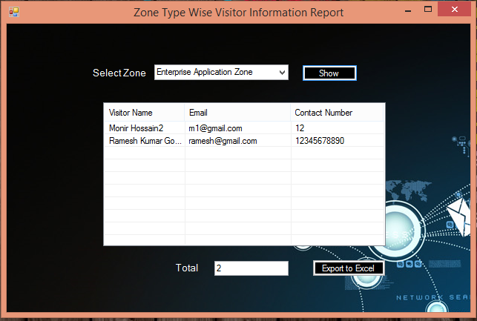
Zone Specific Visitor Info UI

Slide 10
Thanks everyone…

